Slide 1


AWS Cloud Networking
J
ICS 460-02 Darren Isaacson, Jemina Maasin, Alex Jones
Notes:
JEMINA:

Slide 2

Outline
A
Building a VPC
Connecting VPC to MCN
Using SDN with MCN

Slide 3
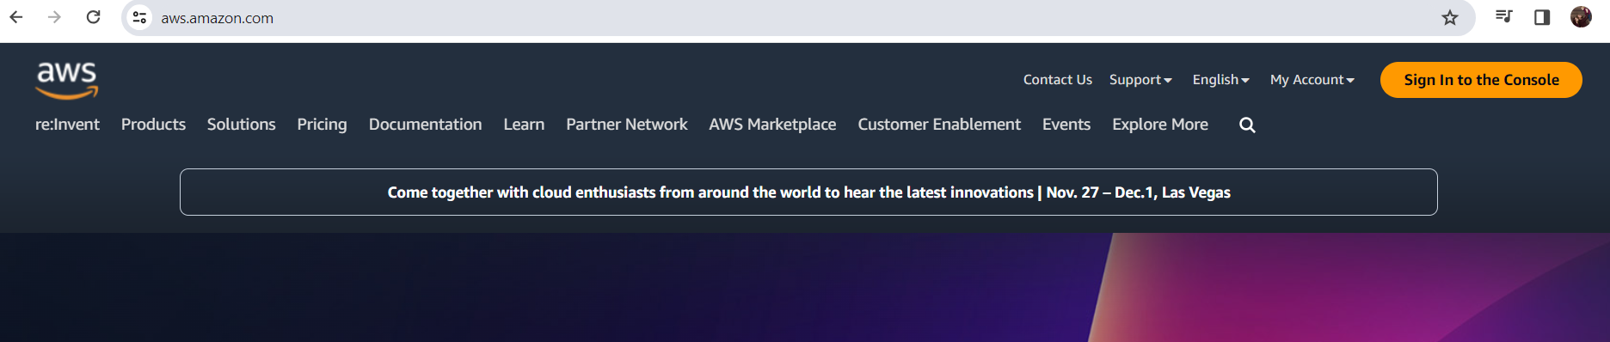
Building Your Virtual Private Cloud with AWS
D
There are several ways to produce a VPC in various cloud providers. We will use the AWS tools for this project.
You will need to create an AWS account to access AWS services.
Notes:
DARREN:

Slide 4
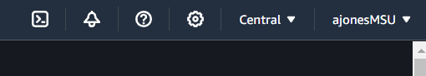
Building Your Virtual Private Cloud with AWS
J
When creating a VPC, choose a region. AWS provides many available Local Zones.
Now you are ready to create your VPC!
Notes:
Jem: When creating a VPC, you need to chose a riegon you want to use. AWS actually provides many available Local Zones especially inside US. But in this example, Alex chose to use Canada. After this step, you are ready to create your own VCP!

Slide 5
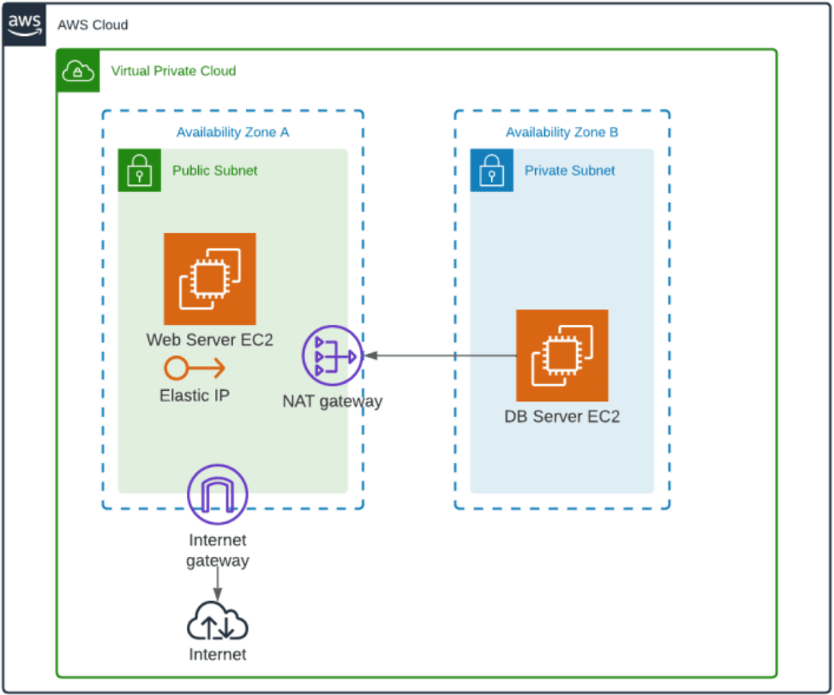
Building Your Virtual Private Cloud with AWS
A
Our VPC will need a public and private subnet. The public subnet will have internet accessibility, and the private subnet will not. This ensures that the private subnet can access the internet through the public subnet, but not directly.
This traffic control is determined through use of Route Tables.

Slide 6
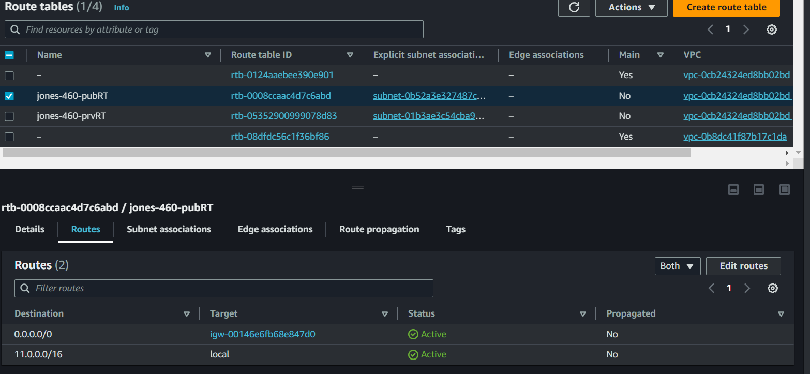
Building Your Virtual Private Cloud with AWS
D
In a VPC, route tables are used to direct traffic within the VPC itself. Routes will need an internet gateway as a target to access the internet. Each route table is associated with a subnet or edge.
Public Route Table
Internet Route
Notes:
Routing help navigate network traffic. 0.0.0.0/0 is the internet
11.0.0.0/16 is the local

Slide 7
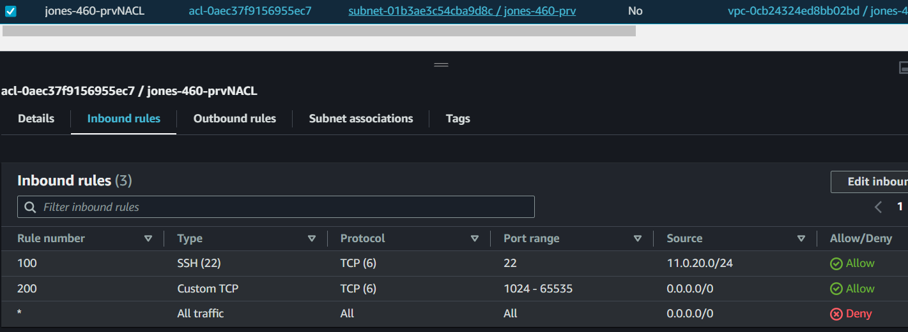
Building Your Virtual Private Cloud with AWS
A
The subnets have their own traffic controller in the network ACL. Similarly to the security groups, they allow traffic based on rules.
NACL rules look similar to security groups, with some additional details.

Slide 8
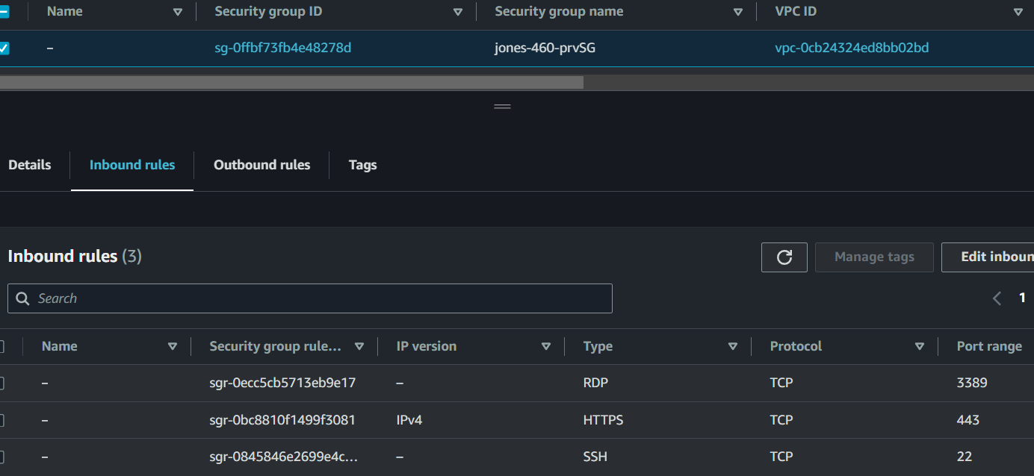
Building Your Virtual Private Cloud with AWS
J
Traffic is partially controlled through security groups. These groups contain a set of rules for inbound and outbound traffic for an instance.
Inbound rules allowing different TCP traffics
Notes:
Jem:
Traffic is partially controlled through security groups, and these groups have sets of rules for inbound and outbound traffic.
In this example, there are different types of traffics that are using TCP protocol such as RDP, HTTPS, and SSH.

Slide 9
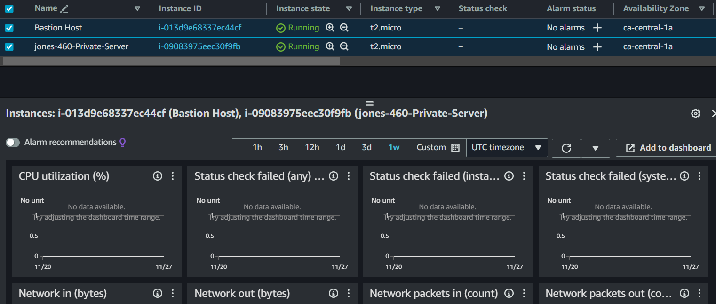
Building Your Virtual Private Cloud with AWS
D
Launching a server in the VPC is called an instance. This is where all our hard work comes together, and we can use the VPC!
We can see both the private instance and public instance running here. Below are different monitors of the instances.

Slide 10
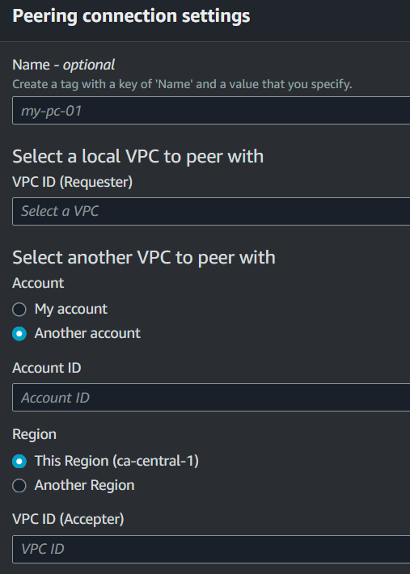
Building Your Virtual Private Cloud with AWS
J
Logically, every VPC is isolated from other VPC which means working between VPCs requires passing data over the internet. AWS removes this step by allowing peering.
We need the VPC ID from both VPCs
We need any foreign Account ID involved in the peering connection
We also need the region!
Notes:
Jem:
Every VPC is isolated from other VPC which means working between VPC requires passing data over the internet. By peering, we eliminate the need to route across the internet, and instead communicate directly as if the VPC were in the same network.

Slide 11
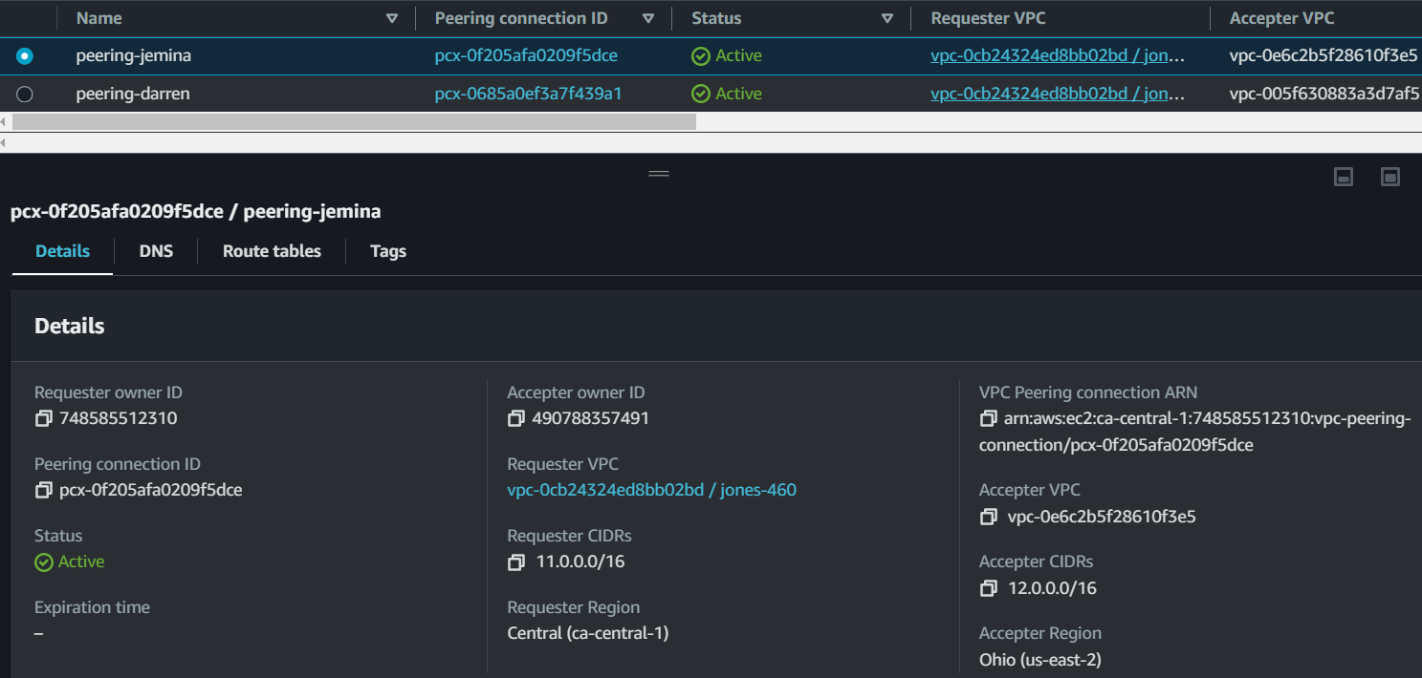
Building Your Virtual Private Cloud with AWS
A
Since we created our VPC with the intention of peering them together, we used different CIDR blocks for each of our VPC. This ensures peering success.
Now our clouds are connected! They will communicate much like their own network, without requiring internet.

Slide 12





SDN and AWS
Route Tables
A
Security Groups
Network Access Control Lists
AWS provides native SDN in the setup process of the VPC.

Slide 13
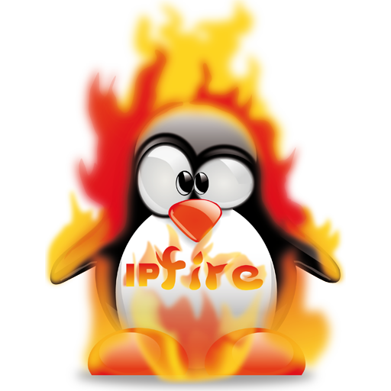
More about SDN: Firewalls with AWS
D
While most of the SDN tools used by AWS thus far deal with inter-VPC operations, firewalls control traffic from external sources to the network. AWS Network Firewall is a native option for this, but others exist such as IPFire.
Notes:
Darren: The key takeaway is firewall are SDN that handle external data to the vpc while security groups are internal to the vpc.

Slide 14
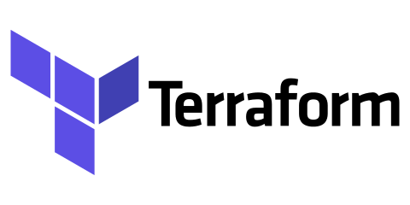
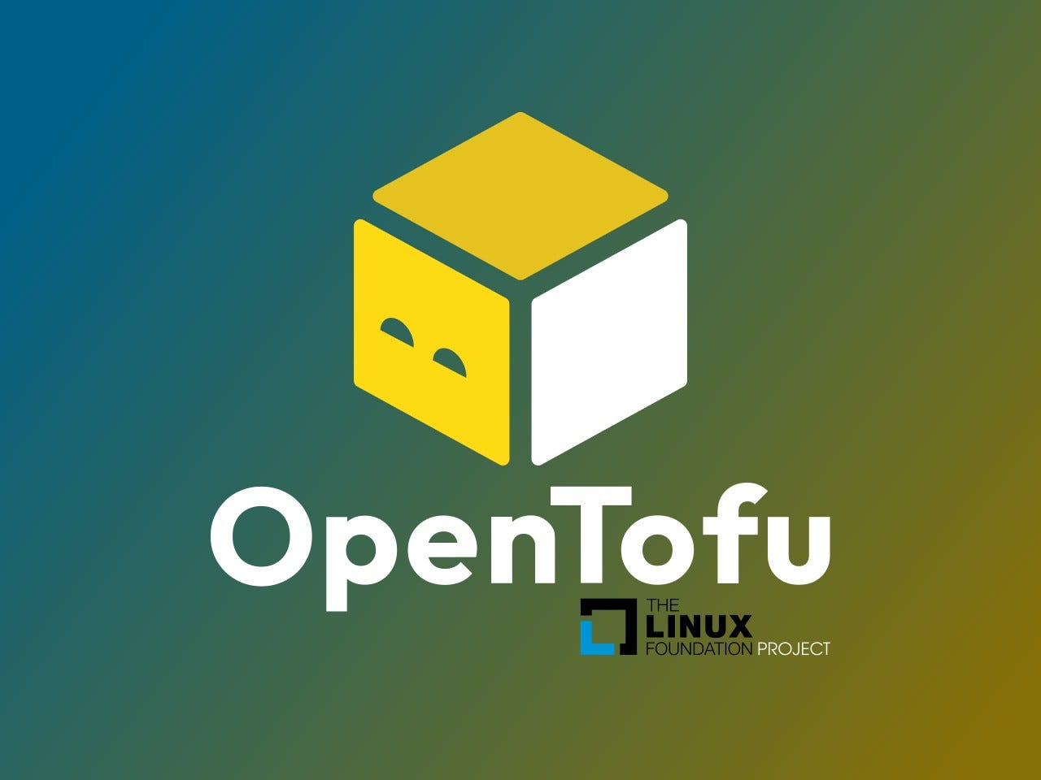
Alternate kinds of SDN (IAC: Infrastructure as Code)
J
IaC allow programming to enter the space of VPC setup.
While AWS site is more user-friendly, Terraform can run a single script and accomplish all of the steps we took in setting up our MCN.
OpenTofu is an open source version of Terraform.
Notes:
Jem:
As another kind of SDN, we can allow Infrastructure as Code, which is using programming languages such as Terraform and OpenTofu, be a part of the VPC set up.
We have seen this in action by our professor using Terraform in AWS. Another programming language is OpenTofu which is an open source version of Terraform and relatively new.

Slide 15

Thank You!
:)
Any questions?
Notes:
WE OUT

